Slide 1
UAS VTOL
Status Update: 2
Nicholas Darden, Vivian Fakharizadeh, Zavia Harris, Richard Jones, Trent Jones, Joshua Lee, Ryan McLaughlin, Rushal Patel, Brendan Regan, Quinton Vehon

Slide 2
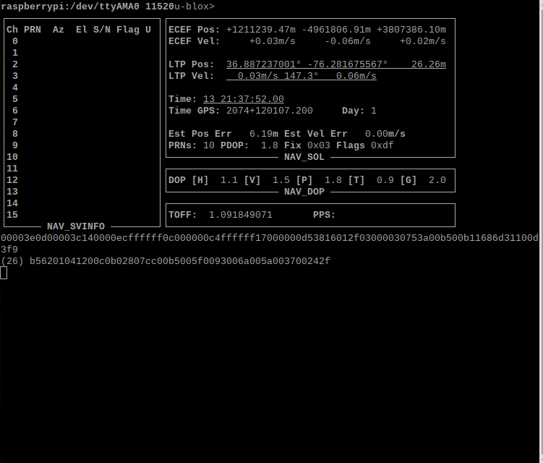
GPS
Component Implementation Complete!

Slide 3
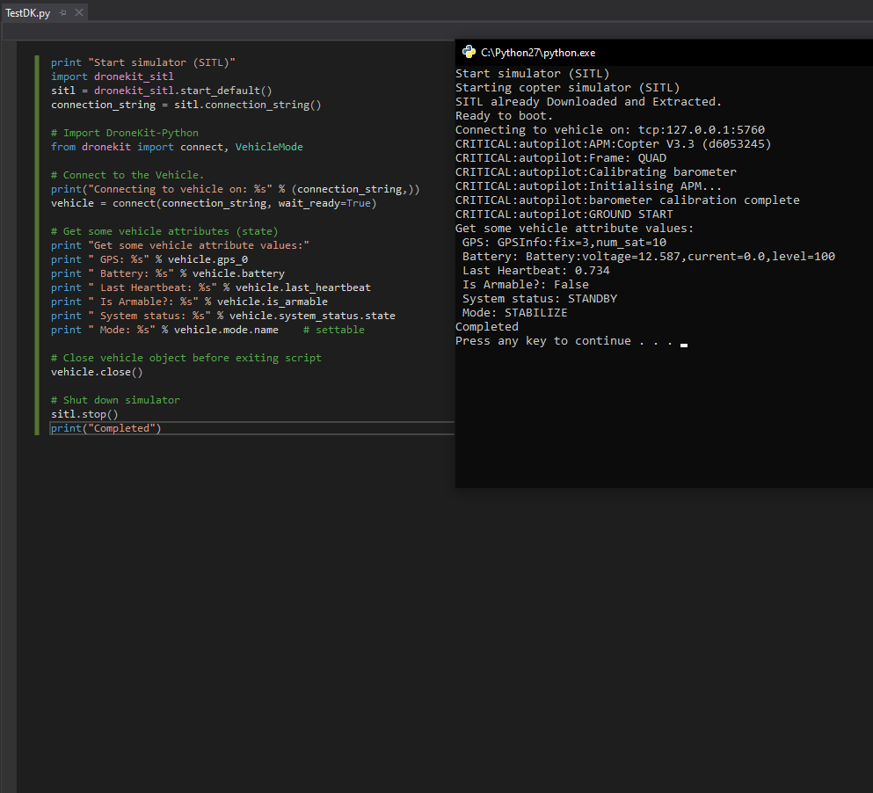
DroneKit
What is DroneKit
How it effects our plans
Completed
Install tutorial
DroneKit Flight Command Script

Slide 4
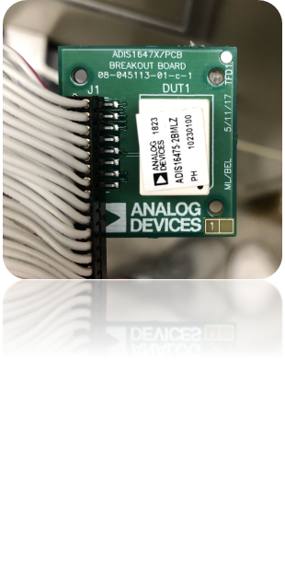
IMU Dead Reckoning Current
Working EKF implemented into the code.
Minor adjustments to be made.
Efficient integration with our existing code to get most accurate results.
Testing to ensure accuracy and all calculations are working properly.
Focus on bias control after we are satisfied with the accuracy of the EKF results.

Slide 5
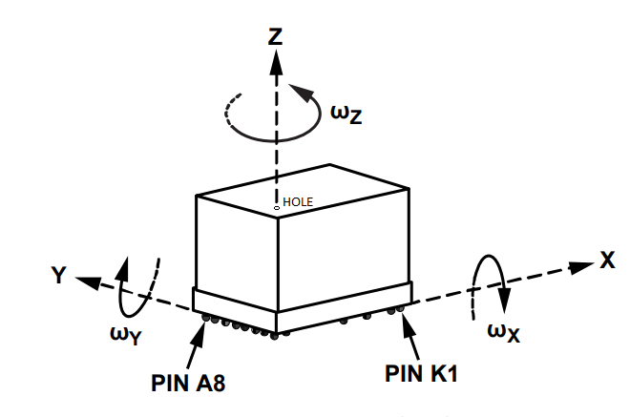
IMU Dead Reckoning Current
Testing to ensure accuracy and all calculations are working properly.
Focus on bias control after we are satisfied with the accuracy of the EKF results.
Static tests
Linear tests
Also, we plan to test the gyroscope to make sure it is calibrated and accurate.
Axis pivot test such as a swinging door, or rotating pendulum

Slide 6
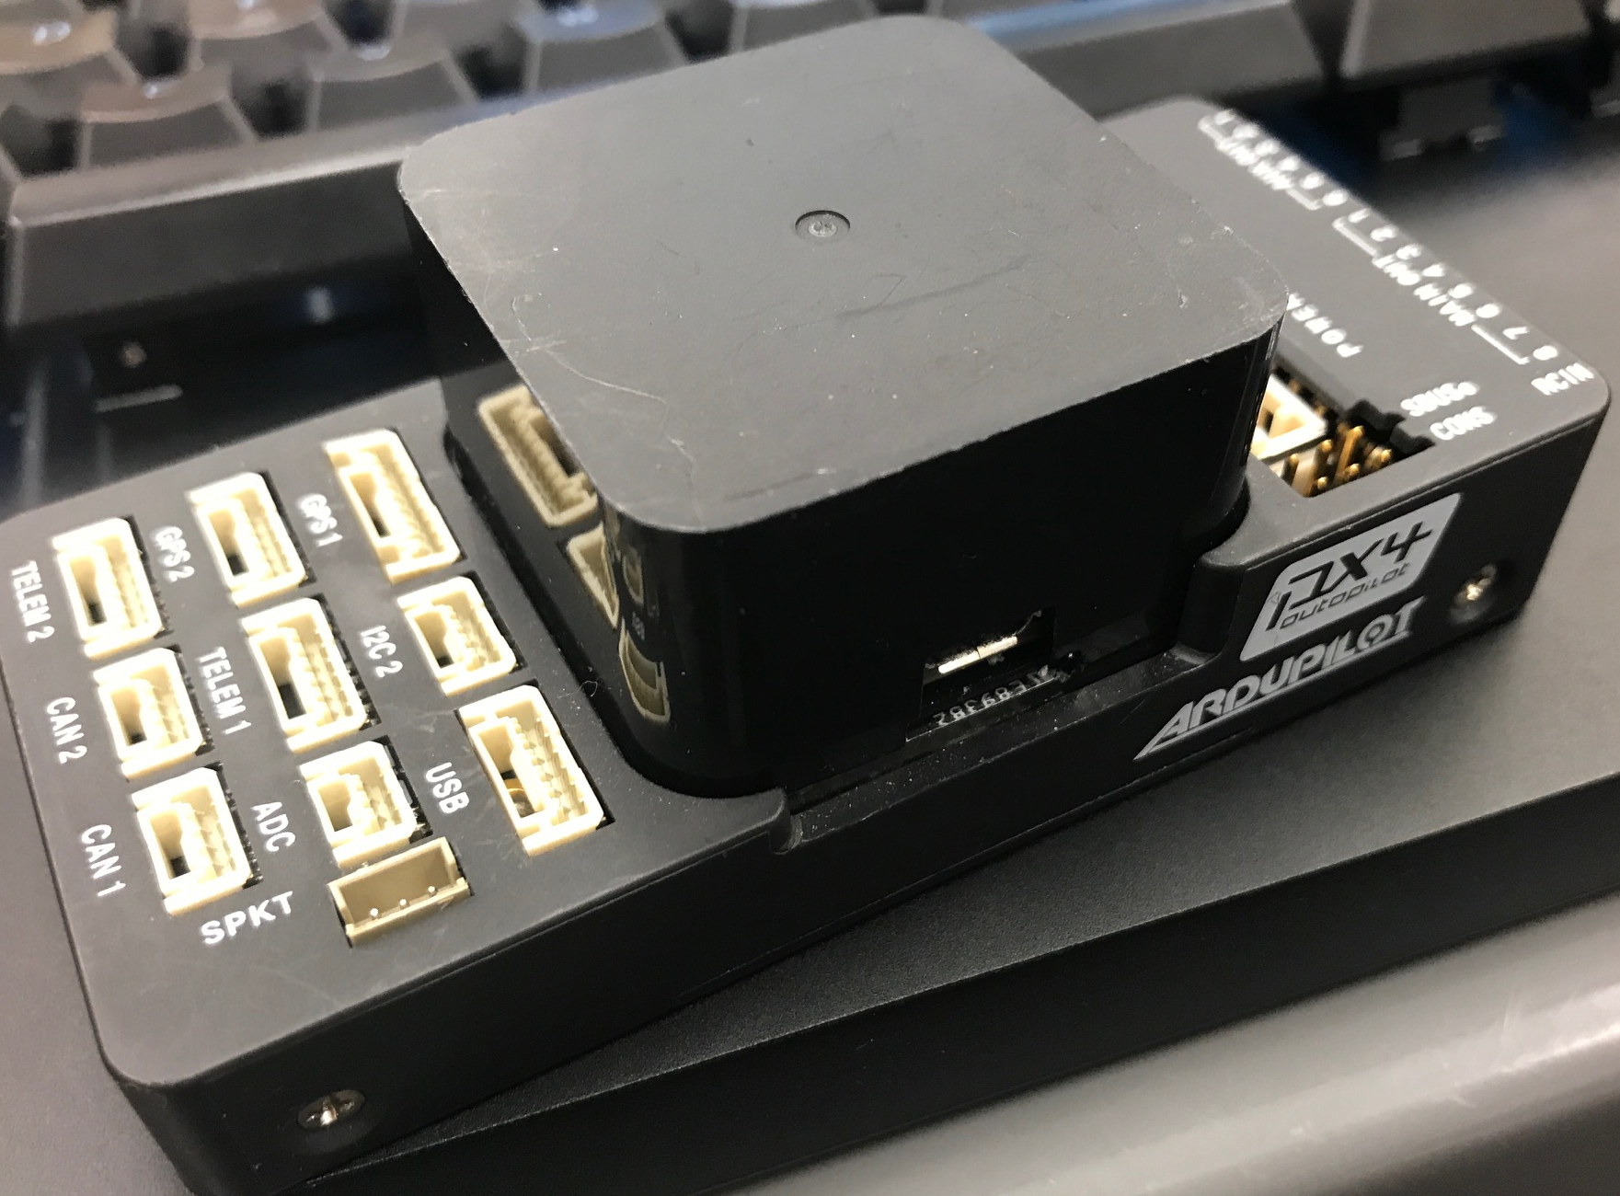
Visual Odometry
Current Tasks:
Connecting the Raspberry Pi and Pixhawk 2.1
Updating current object detection script
Updating new Senior Design Team with current goals
Troubleshooting:
When connecting the Pixhawk and Pi, no signal is being received by the pi.
Corrupted SD pushed the current tasks back. Currently redownloading everything again.
Future Tasks:
Plan and Write landing script using Object tracking functions
Work with the new team on testing the scripts
Backup current progress on multiple SD cards

Slide 7
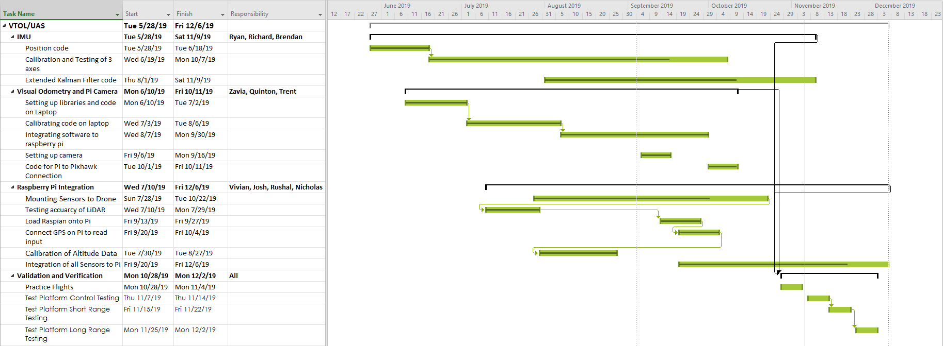
Gantt Chart

